Slide 1
Booki
Real team six (Team 6)

Slide 2
Problem Statement
Booki is a web application designed for college students. We are providing a way for students to earn a portion of their money back from books, by allowing them to set their own prices and participate in transactions with other students, instead of having a middle man. To keep the transaction process purely tailored for the user, Booki does not participate in nor conducts any sales through the application, but rather gives users the ability to control their own buying, selling, or trading experience.
Booki shall prompt the user to log in using their email and password, and the application will perform authentication or enact the proper security methods. If the user does not have an account, Booki shall prompt user to create one. The web application shall allow users to create a new account via a registration page. The application will take the user to their account page, where they can view their book postings, transactions and messages. The application shall allow a user to update their account information if they choose to.

Slide 3
Problem statement (part 2)
Booki will allow users to make new book listings so that the public can see what books are available. Selling, buying, and trading of books shall be handled by the users through private messaging. Booki shall prompt the users for information about their agreed upon transaction (price, location & time), and notify each party of the terms in the form of an email and notifications. The web application will not handle any monetary transactions.
Once the transaction has taken place, Booki shall prompt both users exactly an hour after the scheduled time to update the status of the transaction. This prompt will verify the completed transaction on both sides and allow each user to rate his or her experience. If the prompt is not completed neither user will be allowed to initiate another transaction until it is completed.
Booki shall have a search menu, allowing the user to search for their specific books and courses by different search categories. The web application will run on a Linux server and utilize SQLite as its database.

Slide 4
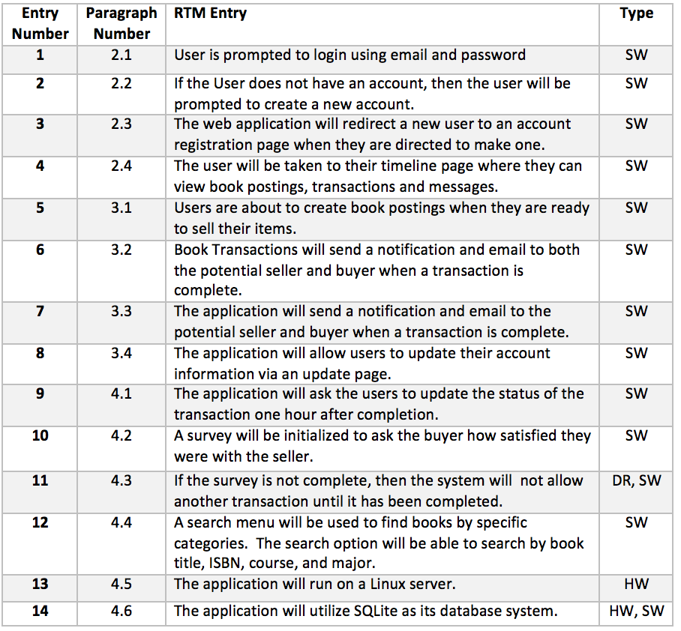
RTM

Slide 5
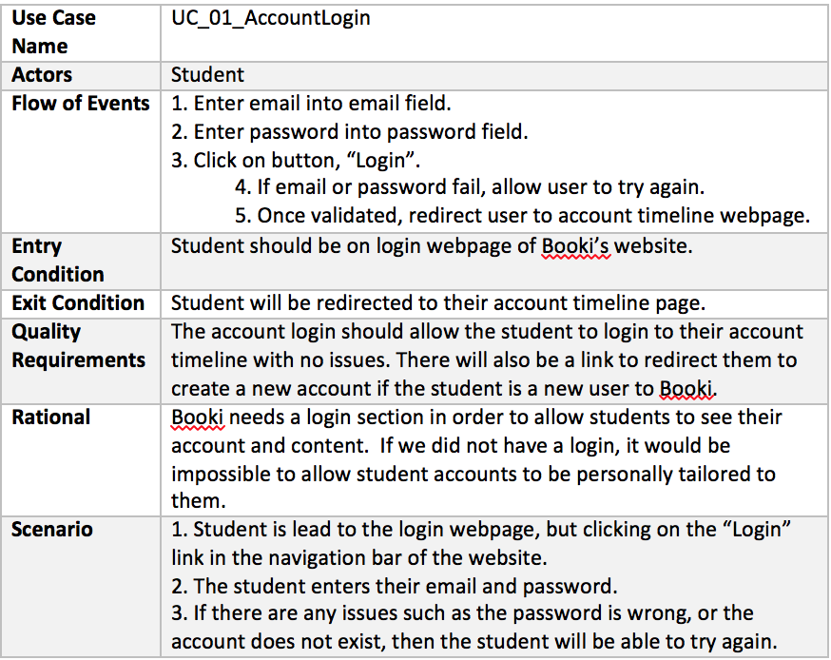
Use Case 1

Slide 6
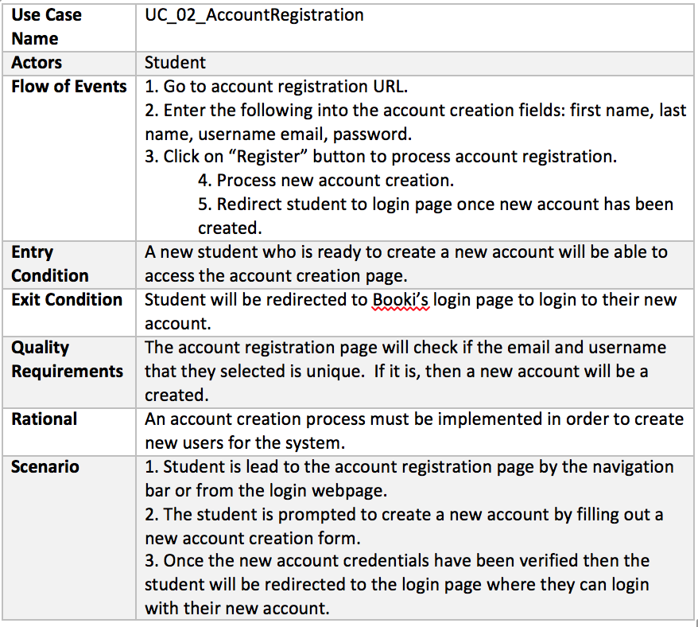
Use case 2

Slide 7
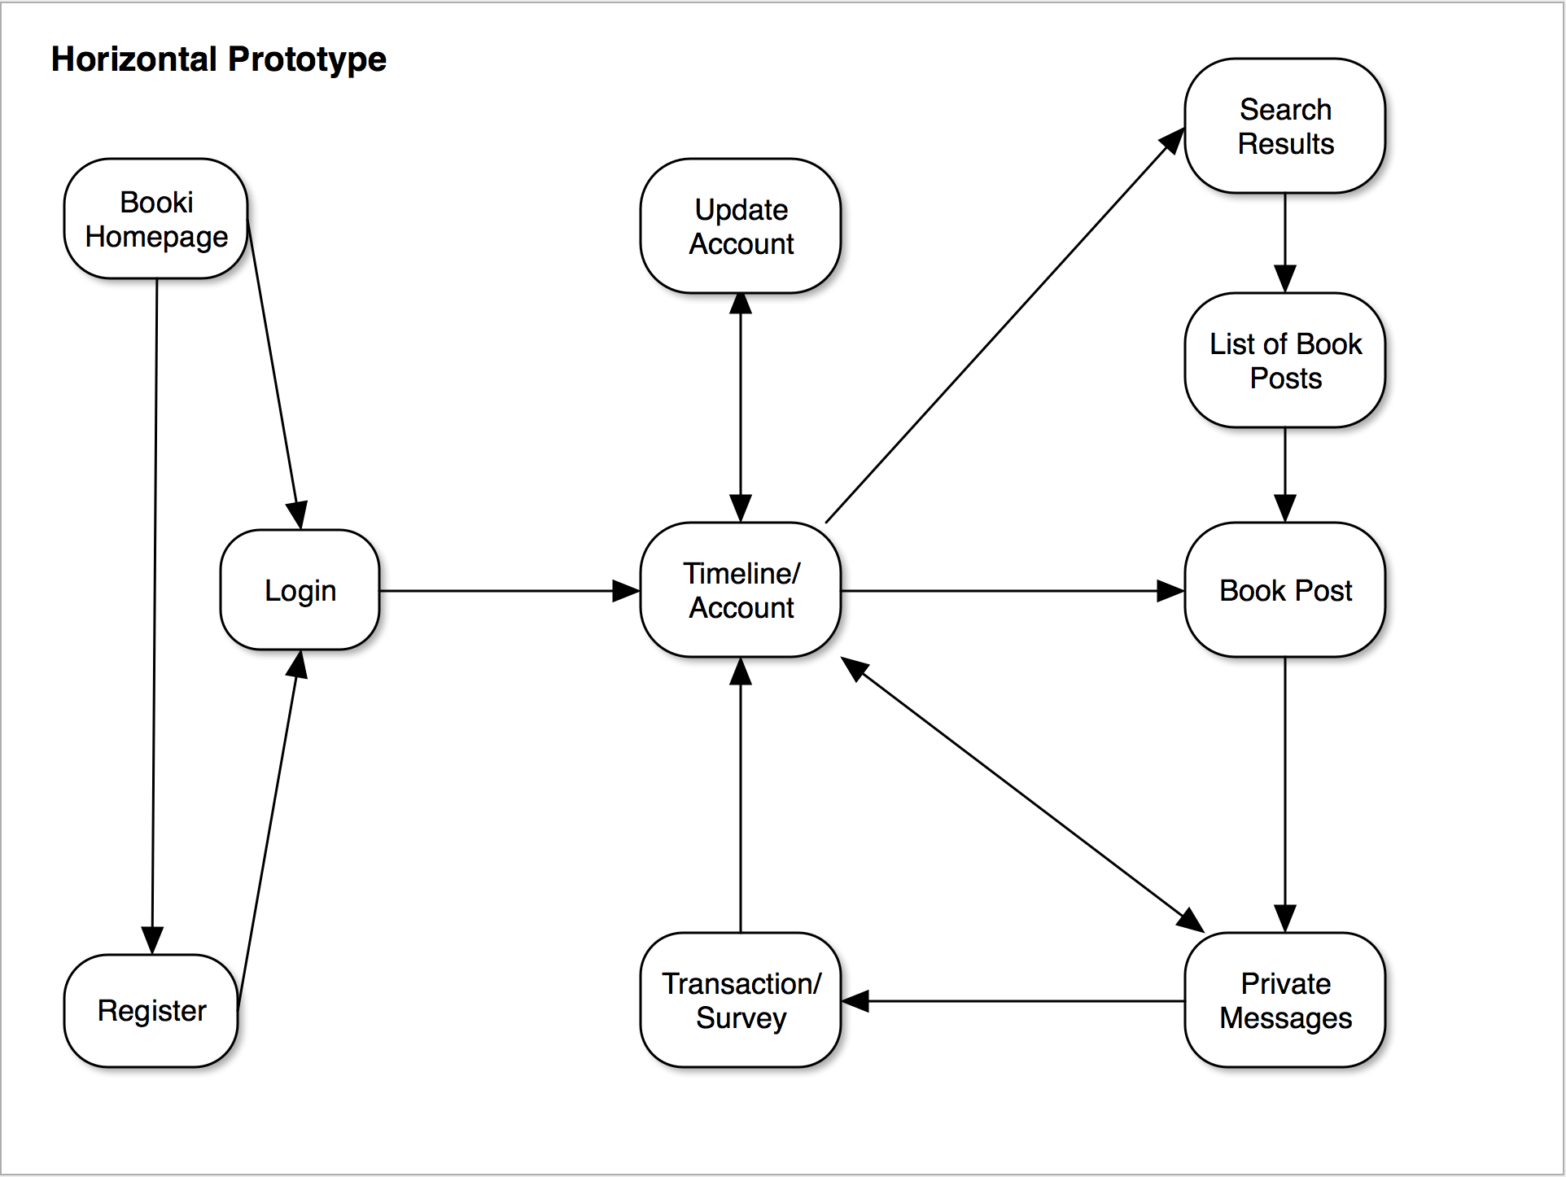

Slide 8
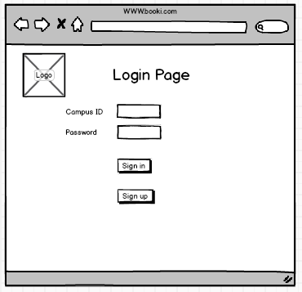
Login Page

Slide 9
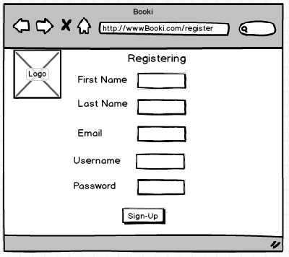
Registration page

Slide 10
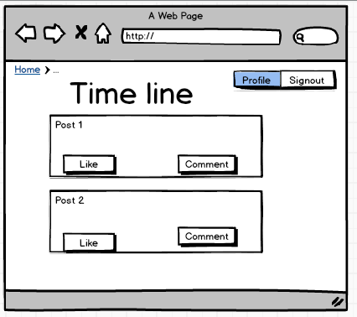
Timeline/Account

Slide 11
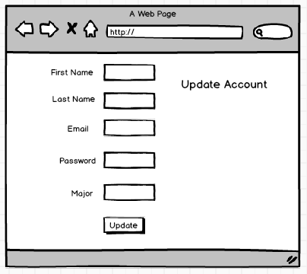
Update account

Slide 12
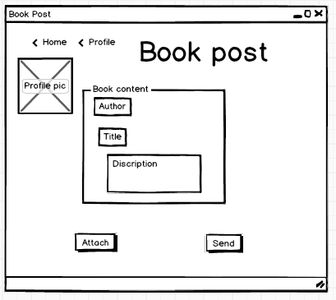
Book Post

Slide 13
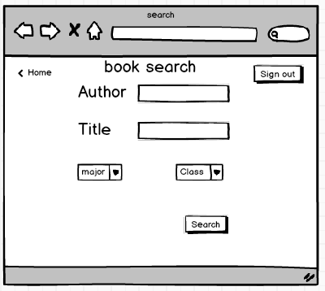
Book search

Slide 14
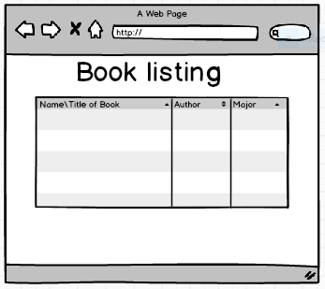
Book Listing

Slide 15
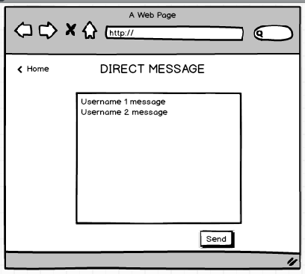
Direct Message

Slide 16
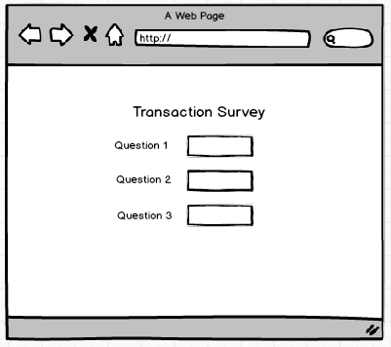
Transaction Survey

Slide 17
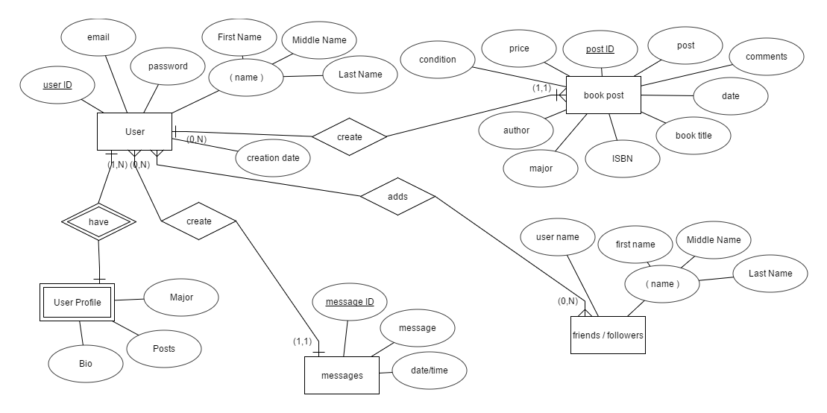
ER diagram

Slide 18
Thank You!
Any Questions?

